Slide 1
USING DATA SCIENCE TO PREDICT CHARITY DONORS TO XYZ NGO
JINDU KWENTUA

Slide 2
FINDINGS
EXPLORATORY DATA ANALYSIS
FEATURE ENGINEERING
REGRECSSION MODEL
CLASSIFICATION MODEL
MODEL PERFORMANCE
PROCESS

Slide 3
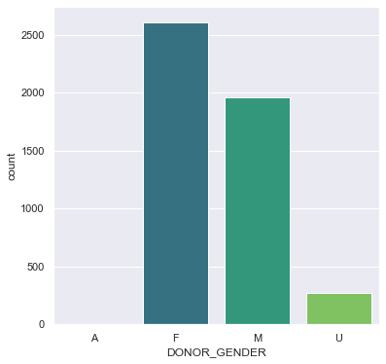
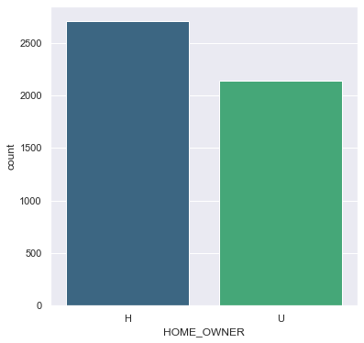
EXPLORATORY DATA ANALYSIS
Here, I tried to observe relationships and find patterns. Here are some findings:
There are more female donors than male donors
Most of the donors are home owners

Slide 4
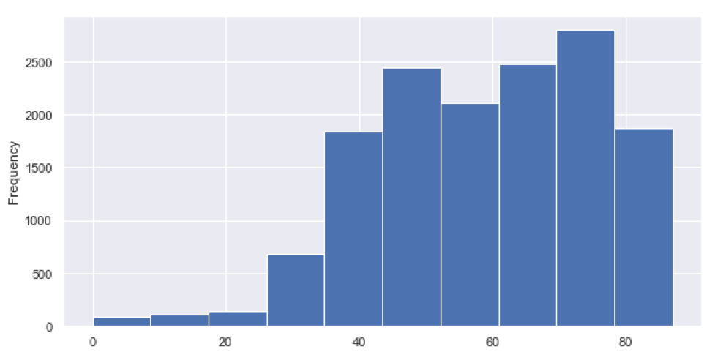
This shows the distribution of donors. Most donors are between the ages of 45 to 75 a demographic we can target
More images
POSITIVE CORRELATIONS WERE OBSERVED BETWEEN:
AMOUNT DONATED
RECENT AVERAGE GIFT AMOUNT
LAST GIFT AMOUNT
FILE AVERAGE GIFT
LIFETIME AVERAGE GIFT AMOUNT
RECENT AVERAGE CARD GIFT AMOUNT
LIFETIME MAX GIFT AMOUNT
LIFETIME GIFT RANGE
LIFETIME MIN GIFT AMT
IFETIME GIFT AMOUNT
PER CAPITA INCOME

Slide 5
FEATURE ENGINEERING STEPS TAKEN BUT NOT LIMITED TO THE FOLLOWING:
Handled missing values
Encoded categorical data
Standardize the data
Recursive featuring engineering for best features

Slide 6
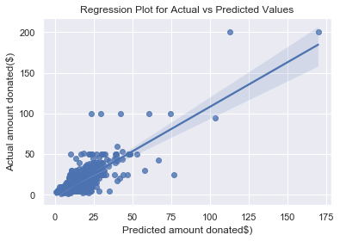
REGRESSION MODEL
I decided to use a regression model to see if I could predict the amount donors would donate and look at the features that supported that.
The best performing mode was a “RidgeCV Regression” model.
The models were graded on RMSE for both train and test set
There isn’t so much difference between the predicted amount and actual amount donated as most value fall within $50

Slide 7
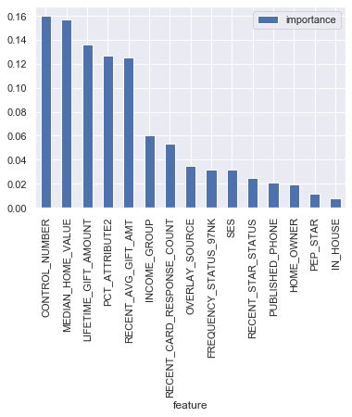
CLASSIFICATION MODEL
I decided to use a classification model to predict the likelihood of a person donating.
The best performing mode was a “ Random Forest Classifier.
The model gave an accuracy of 78%
I was able to predict the probability of a person donating and merging that with the regression model, we should find out features of a person donating and the amount
The chart here shows the feature importance from the top to the least.

Slide 8
FINDINGS
By combining the regression model and Classification model, the top 15 features which help us to predict the probability of a person donating and what amount the donor donates are
RECENT_AVG_GIFT_AMT
LAST_GIFT_AMT
MONTHS_SINCE_ORIGIN
RECENT_AVG_CARD_GIFT_AMT
HOME_OWNER
LIFETIME_CARD_PROMOTIO
MONTHS_SINCE_LAST_GIFT
MEDIAN_HOUSEHOLD_INCOME
CONTROL_NUMBER
FREQUENCY_STATUS_97NK
HOME_OWNER
INCOME_GROUP
IN_HOUSE
LIFETIME_GIFT_AMOUNT
MEDIAN_HOME_VALUE
OVERLAY_SOURCE
PCT_ATTRIBUTE4
PCT_OWNER_OCCUPIED
PEP_STAR
PUBLISHED_PHONE
RECENT_CARD_RESPONSE_COUNT
RECENT_STAR_STATUS
SES

Slide 9
CHALLENGES AND FUTURE WORK
The data used to build the regression model was very small so the model performance averagely good.
More data would be needed to better optimize the performance of the model
More features, I’d advise getting some time and date features to understand the time periods of donations
ADVISE AND RECOMMENDATION
By targeting people with the recommended features XYZ NGO can better optimize their mailing list and have an idea of who is likely to donate and what amount.
I’ll recommend the classification if XYZ NGO wants to know the probability of a person donating thereby savings costs by not mailing those not likely to donate
I’ll recommend the regression model if XYZ NGO wants to find out the range of amount a person would donate

Slide 10
THANK YOU AND ALL THE BEST!!!

